Slide 1
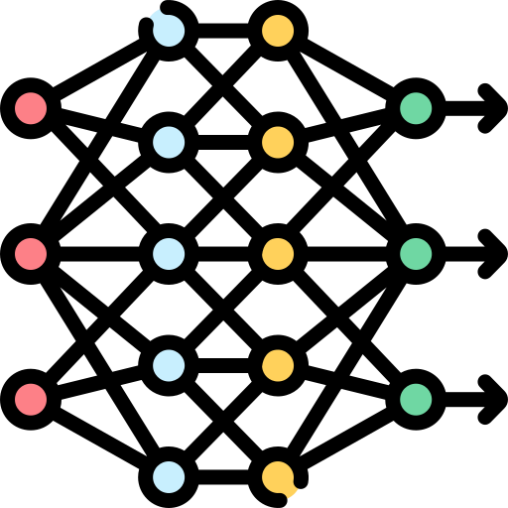
Deep Learning Foundations
•Embeddings •CNNs •Pooling Layer •Transformers
Dr. Khan Muhammad (칸 무하마드)
Associate Professor
Department of Applied Artificial Intelligence
Sungkyunkwan University

Slide 2
Main contents
1. Multimodal Embeddings
2. Convolutional Neural Networks (CNNs)
I. Convolution Operation
3. Types of Layers
I. Max Pooling
II. Average pooling
4. CNN for Classification
I. Applications of CNNs
5. Transformer
I. Attention Mechanism
II. Why Transformers Matter for Multimodal AI
6. CNNs vs. Transformers
7. From CNNs & Transformers to Multimodal AI
2

Slide 3
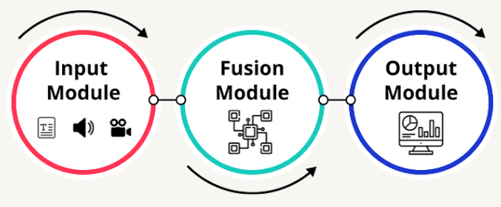
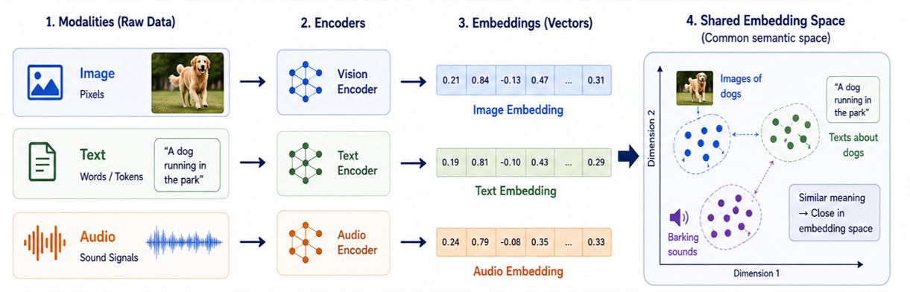
1. Multimodal Embeddings
Multimodal means working with more than one type of data, such as:
Images
Text
Audio
Video
A multimodal embedding converts these different types of data into numerical vectors so that their meaning can be compared.
Main idea
Different modalities can be converted into representations that live in a shared space.
Multimodal embeddings connect different types of data through their meaning.
3

Slide 4
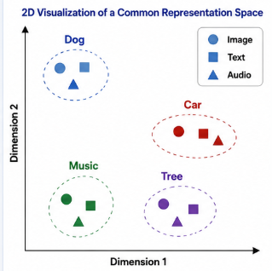

1. Multimodal Embeddings
A common representation space is a shared space where different types of data—such as images, text, and audio—are represented in a way that allows their meanings to be compared.
Key Points
Different modalities are converted into embeddings.
The embeddings are mapped into the same shared space.
Data with similar meanings are placed close together.
Data with different meanings are placed farther apart.
This allows the model to compare information across different modalities.
Points that are semantically similar (same meaning) are close together, even if they came from different modalities.
4

Slide 5
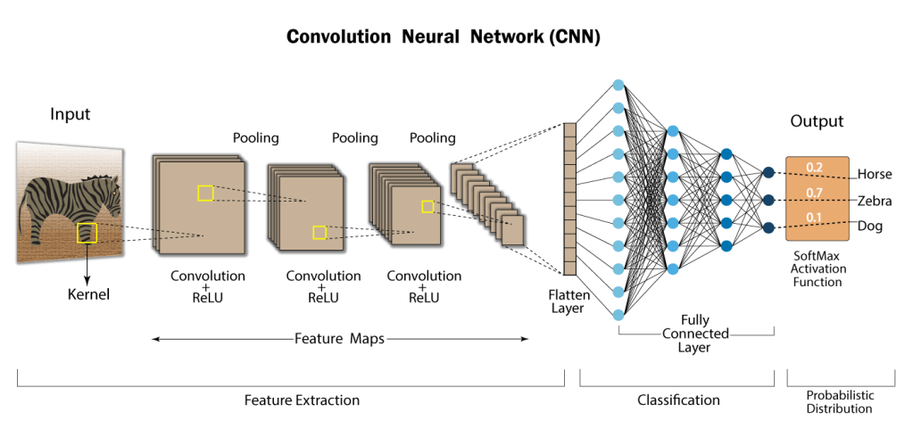
2. Convolutional Neural Networks (CNNs)
Convolutional Neural Networks, commonly referred to as CNNs are a specialized type of neural network designed to process and classify images.
What does it learn?
CNNs learn features hierarchically:
Early layers → Edges, lines, colors
↓
Middle layers → Shapes, textures, patterns
↓
Deep layers → Objects and meaningful visual structures
There are three main operations to CNNs.
Convolution: Apply filters to generate feature maps.
Non-linearity: Often ReLU
Pooling: Down sampling operation on each feature map.
5

Slide 6
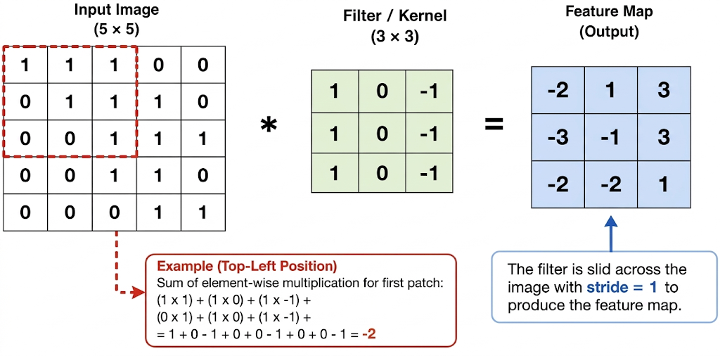
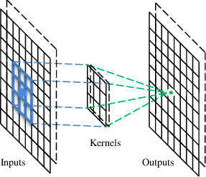
2. Convolutional Neural Networks (CNNs)
Important Parameters
1. Kernel Size
Determines the size of the filter.
Common examples: 3×3, 5×5
Smaller kernels capture fine details; larger kernels capture more context.
2. Stride
Controls how far the filter moves at each step.
Stride = 1: moves one pixel at a time.
3. Padding
Adds pixels, usually zeros, around the image.
Helps control the output's spatial dimensions.
4. Number of Filters
Multiple filters learn different patterns.
Each filter produces a separate feature map.
Key Takeaway
Convolution allows CNNs to automatically detect important visual patterns, which are represented as feature maps and used by deeper layers to recognize complex objects.
CNN Explainer
(https://poloclub.github.io/cnn-explainer/)
6

Slide 7
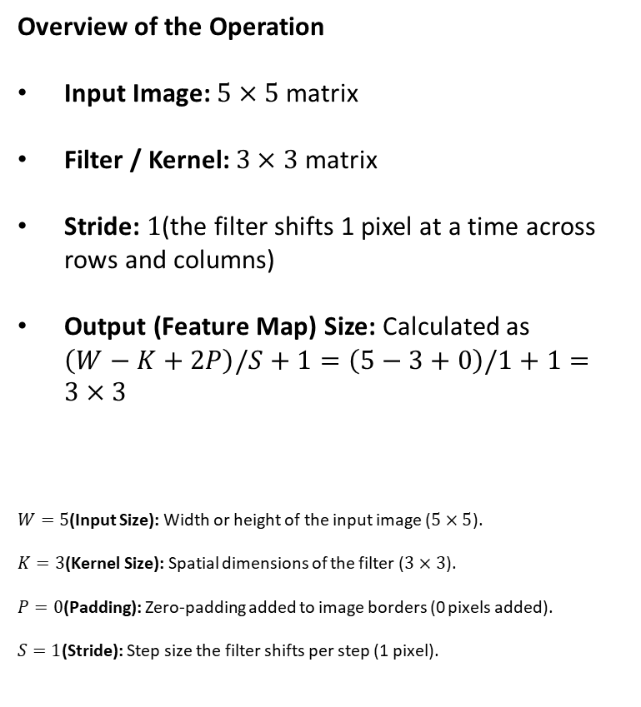
2. (i) Convolution Operation
Overview of the Operation
Input Image: $5×5$ matrix
Filter / Kernel: $3×3$ matrix
Stride: $1$(the filter shifts 1 pixel at a time across rows and columns)
Output (Feature Map) Size: Calculated as $\left(W−K+2P\right)/S+1=\left(5−3+0\right)/1+1=3×3$
$W=5$(Input Size): Width or height of the input image ($5×5$).
$K=3$(Kernel Size): Spatial dimensions of the filter ($3×3$).
$P=0$(Padding): Zero-padding added to image borders (0 pixels added).
$S=1$(Stride): Step size the filter shifts per step (1 pixel).
1 | 0 | 1 | 0 | 1
1 | 0 | 0 | 1 | 1
0 | 1 | 1 | 0 | 0
1 | 0 | 0 | 1 | 0
0 | 0 | 1 | 1 | 0
0 | 1 | 0
1 | 0 | -1
0 | 1 | 0
2 | 1 | -1
-1 | 1 | 3
2 | 1 | 1
=
*
Filter or Kernel
Output or Feature Map
Input Image
Click Here to Explore Convolutional Operations
7

Slide 8
2. (i) Convolution Operation
(1 × 0) + (0 × 1) + (1 × 0) + (1 × 1) + (0 × 0) + (0 × −1) + (0 × 0) + (1 × 1) + (1 × 0) = 2
 |  |  |  |  |  |  |  |  | 0 | 1
1x0 |  |  | 0x | 1 |  | 1x | 0
1x1 |  |  | 0x | 0 |  | 0x | -1 |  | 1 | 1
0x | 0 |  | 1x1 |  |  | 1x | 0 |  | 0 | 0
1 |  |  | 0 |  |  | 0 |  |  | 1 | 0
0 |  |  | 0 |  |  | 1 |  |  | 1 | 0
0 | 1 | 0
1 | 0 | -1
0 | 1 | 0
2
*
=
Filter or Kernel
Output or Feature Map
Input Image
8

Slide 9
2. (i) Convolution Operation
(0 × 0) + (1 × 1) + (0 × 0) + (0 × 1) + (0 × 0) + (1 × −1) + (1 × 0) + (1 × 1) + (0 × 0) = 1
1 | 0x0 | 1x1 | 0x0 | 1
1 | 0x1 | 0x0 | 1x-1 | 1
0 | 1x0 | 1x1 | 0x0 | 0
1 | 0 | 0 | 1 | 0
0 | 0 | 1 | 1 | 0
0 | 1 | 0
1 | 0 | -1
0 | 1 | 0
2 | 1
*
=
Filter or Kernel
Output or Feature Map
Input Image
9

Slide 10
2. (i) Convolution Operation
(1× 0) + (0 × 1) + (1 × 0) + (0 × 1) + (1 × 0) + (1 × −1) + (1 × 0) + (0 × 1) + (0 × 0) = -1
1 | 0 | 1x0 | 0x1 | 1x0
1 | 0 | 0x1 | 1x0 | 1x-1
0 | 1 | 1x0 | 0x1 | 0x0
1 | 0 | 0 | 1 | 0
0 | 0 | 1 | 1 | 0
0 | 1 | 0
1 | 0 | -1
0 | 1 | 0
2 | 1 | -1
*
=
Filter or Kernel
Output or Feature Map
Input Image
10

Slide 11
2. (i) Convolution Operation
(1× 0) + (0 × 1) + (0 × 0) + (0 × 1) + (1 × 0) + (1 × −1) + (1 × 0) + (0 × 1) + (0 × 0) = -1
1 | 0 | 1 | 0 | 1
1x0 | 0x1 | 0x0 | 1 | 1
0x1 | 1x0 | 1x-1 | 0 | 0
1x0 | 0x1 | 0x0 | 1 | 0
0 | 0 | 1 | 1 | 0
0 | 1 | 0
1 | 0 | -1
0 | 1 | 0
2 | 1 | -1
-1
*
=
Filter or Kernel
Output or Feature Map
Input Image
11

Slide 12
2. (i) Convolution Operation
(0× 0) + (0 × 1) + (1 × 0) + (1 × 1) + (1 × 0) + (0 × −1) + (0 × 0) + (0 × 1) + (1 × 0) = 1
1 | 0 | 1 | 0 | 1
1 | 0x0 | 0x1 | 1x0 | 1
0 | 1x1 | 1x0 | 0x-1 | 0
1 | 0x0 | 0x1 | 1x0 | 0
0 | 0 | 1 | 1 | 0
0 | 1 | 0
1 | 0 | -1
0 | 1 | 0
2 | 1 | -1
-1 | 1
*
=
Filter or Kernel
Output or Feature Map
Input Image
12

Slide 13
2. (i) Convolution Operation
(0× 0) + (1 × 1) + (1 × 0) + (1 × 1) + (0 × 0) + (0 × −1) + (0 × 0) + (1 × 1) + (0 × 0) = 3
1 | 0 | 1 | 0 | 1
1 | 0 | 0x0 | 1x1 | 1x0
0 | 1 | 1x1 | 0x0 | 0x-1
1 | 0 | 0x0 | 1x1 | 0x0
0 | 0 | 1 | 1 | 0
0 | 1 | 0
1 | 0 | -1
0 | 1 | 0
2 | 1 | -1
-1 | 1 | 3
*
=
Filter or Kernel
Output or Feature Map
Input Image
13

Slide 14
2. (i) Convolution Operation
(0× 0) + (1 × 1) + (1 × 0) + (1 × 1) + (0 × 0) + (0 × −1) + (0 × 0) + (0 × 1) + (1 × 0) = 2
1 | 0 | 1 | 0 | 1
1 | 0 | 0 | 1 | 1
0x0 | 1x1 | 1x0 | 0 | 0
1x1 | 0x0 | 0x-1 | 1 | 0
0x0 | 0x1 | 1x0 | 1 | 0
0 | 1 | 0
1 | 0 | -1
0 | 1 | 0
2 | 1 | -1
-1 | 1 | 3
2
*
=
Filter or Kernel
Output or Feature Map
Input Image
14

Slide 15
2. (i) Convolution Operation
(1× 0) + (1 × 1) + (0 × 0) + (0 × 1) + (0 × 0) + (1 × −1) + (0 × 0) + (1 × 1) + (1 × 0) = 1
1 | 0 | 1 | 0 | 1
1 | 0 | 0 | 1 | 1
0 | 1x0 | 1x1 | 0x0 | 0
1 | 0x1 | 0x0 | 1x-1 | 0
0 | 0x0 | 1x1 | 1x0 | 0
0 | 1 | 0
1 | 0 | -1
0 | 1 | 0
2 | 1 | -1
-1 | 1 | 3
2 | 1
*
=
Filter or Kernel
Output or Feature Map
Input Image
15

Slide 16
2. (i) Convolution Operation
(1× 0) + (0× 1) + (0 × 0) + (0 × 1) + (1 × 0) + (0 × −1) + (1 × 0) + (1 × 1) + (0 × 0) = 1
1 | 0 | 1 | 0 | 1
1 | 0 | 0 | 1 | 1
0 | 1 | 1x0 | 0x1 | 0x0
1 | 0 | 0x1 | 1x0 | 0x-1
0 | 0 | 1x0 | 1x1 | 0x0
0 | 1 | 0
1 | 0 | -1
0 | 1 | 0
2 | 1 | -1
-1 | 1 | 3
2 | 1 | 1
*
=
Filter or Kernel
Output or Feature Map
Input Image
16

Slide 17
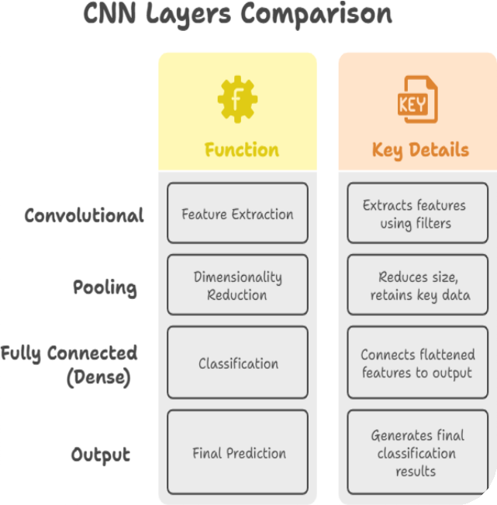
3. Types of Layers
CNNs consist of specialized layers that efficiently process spatial data like images.
1) Convolutional Layer
Extracts features (edges, textures, patterns) using filters.
Preserves spatial structure.
Activation functions (e.g., ReLU) are applied after this layer.
Helps learn complex patterns.
Pooling Layer
  Reduces dimensionality while retaining key features.
  Common types: Max Pooling, Average Pooling.
Fully Connected (Dense) Layer
  Flattens feature maps and connects to output neurons.
  Used for classification tasks.
Output Layer
  Produces final predictions (e.g., Softmax for multi-class classification).
Flatten layer
The Flatten layer in a CNN converts the learned information into a single long list of numbers.
Suppose a CNN produces these values:
[1, 2, 3]
[4, 5, 6]
The Flatten layer converts them into one long list:
[1, 2, 3, 4, 5, 6]
Then this list is passed to the Fully Connected (Dense) Layer for classification.
17

Slide 18
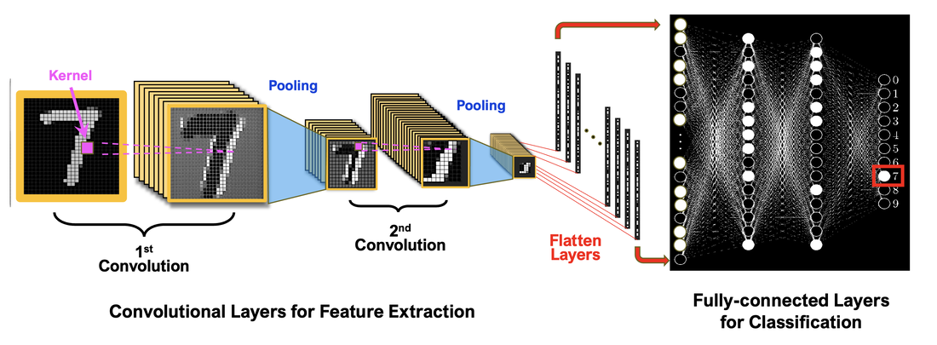
3. Types of Layers (Example)
The Flatten layer converts a multi-dimensional feature map into a single one-dimensional vector.
For example:
2D feature maps → 1D vector → Fully Connected Layer → Output
In simple words: Flatten prepares the CNN features for classification.
CNNs automatically learn visual features—from simple edges to complex objects—directly from images.
18

Slide 19
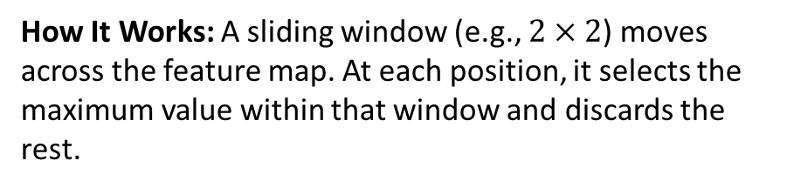
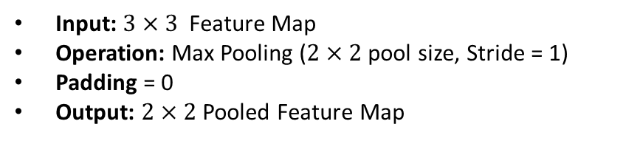
3. (i) Max Pooling
Max Pooling: is a down sampling (subsampling) operation used in Convolutional Neural Networks (CNNs) to reduce the spatial dimensions (width and height) of feature maps while retaining the most dominant features.
2 | 1 | -1
-1 | 1 | 3
2 | 1 | 1
2 | 3
2 | 3
Primary Purposes
Dimensionality Reduction: Shrinks feature map size to reduce computation and memory usage.
Translation Invariance: Keeps features detectable despite minor shifts or distortions.
Overfitting Prevention: Reduces spatial resolution to prevent memorizing pixel-level noise.
Output
How It Works: A sliding window (e.g., $2×2$) moves across the feature map. At each position, it selects the maximum value within that window and discards the rest.
Feature Map
Input: $3×3$ Feature Map
Operation: Max Pooling ($2×2$ pool size, Stride = 1)
Padding = 0
Output: $2×2$Pooled Feature Map
https://www.sciencedirect.com/topics/computer-science/average-pooling
https://www.geeksforgeeks.org/deep-learning/introduction-to-pooling-layer-cnn/
19

Slide 20
3. (i) Max Pooling Operation
Max Pooling : takes the maximum value
2 | 1 | -1
-1 | 1 | 3
2 | 1 | 1
2
Output
Feature Map
20

Slide 21
3. (i) Max Pooling Operation
Max Pooling : takes the maximum value
2 | 1 | -1
-1 | 1 | 3
2 | 1 | 1
2 | 3
Output
Feature Map
40
21

Slide 22
Example of a Convolution Operation
3. (i) Max Pooling Operation
Max Pooling : takes the maximum value
2 | 1 | -1
-1 | 1 | 3
2 | 1 | 1
2 | 3
2
Output
Feature Map
40
40
22

Slide 23
Example of a Convolution Operation
3. (i) Max Pooling Operation
Max Pooling : takes the maximum value
2 | 1 | -1
-1 | 1 | 3
2 | 1 | 1
2 | 3
2 | 3
Output
Feature Map
40
40
40
23

Slide 24
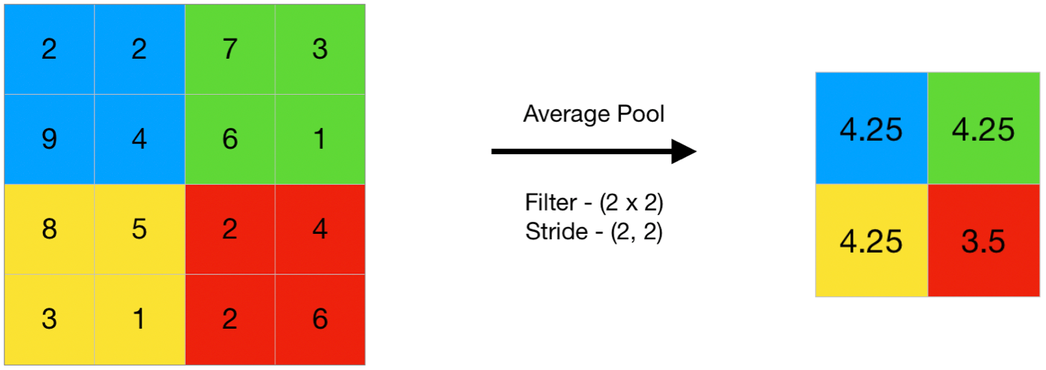

Example of a Convolution Operation
3. (ii) Average pooling
Average pooling: is a down sampling operation that reduces the spatial dimensions (width and height) of a feature map by calculating the arithmetic mean of values within a sliding window.
Core Concept: Unlike Max Pooling (which selects the highest value in a region), Average Pooling calculates the average intensity across all pixels inside the pool window.
Key Properties
Smooth Feature Extraction: Blurs extreme activations, keeping overall background context rather than just sharp edges or maximum spikes.
Parameter-Free: Operates deterministically (fixed rule) without any trainable weights or biases.
Padding = 0
Output
40
40
40
24

Slide 25



Example of a Convolution Operation
3. (ii) Average pooling Operation
Top-Left Region: $\frac{2+2+9+4}{4}=\frac{17}{4}=4.25$
2
2
7
3
9
4
6
1
Average Pooling
$$4.25$$
8
5
2
4
Filter Size – (2x2)
Strid – (2,2)
3
1
2
6
Padding = 0
40
40
40
25

Slide 26


Example of a Convolution Operation
3. (ii) Average pooling Operation
Top-Right Region: $\frac{7+3+6+1}{4}=\frac{17}{4}=4.25$
2
2
7
3
9
4
6
1
Average Pooling
$$4.25$$
$$4.25$$
8
5
2
4
Filter Size – (2x2)
Strid – (2,2)
3
1
2
6
Padding = 0
40
40
40
26

Slide 27


Example of a Convolution Operation
3. (ii) Average pooling Operation
Bottom-Left Region: $\frac{8+5+3+1}{4}=\frac{17}{4}=4.25$
2
2
7
3
9
4
6
1
Average Pooling
$$4.25$$
$$4.25$$
8
5
2
4
$$4.25$$
Filter Size – (2x2)
Strid – (2,2)
3
1
2
6
Padding = 0
40
40
40
27

Slide 28


Example of a Convolution Operation
3. (ii) Average pooling Operation
Bottom-Right Region: $\frac{2+4+2+6}{4}=\frac{14}{4}=3.50$
2
2
7
3
9
4
6
1
Average Pooling
$$4.25$$
$$4.25$$
8
5
2
4
$$4.25$$
$$3.50$$
Filter Size – (2x2)
Strid – (2,2)
3
1
2
6
Padding = 0
40
40
40
28

Slide 29
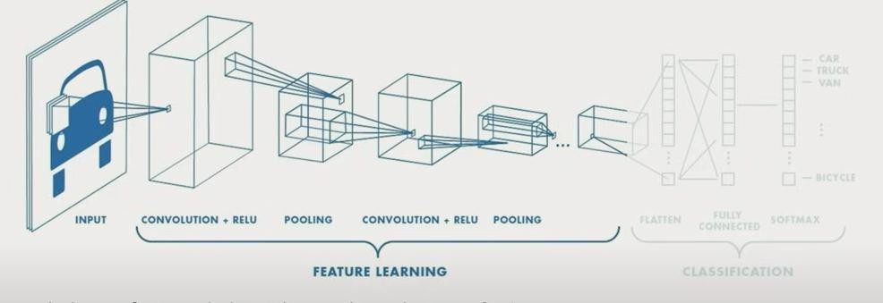
4. CNN for Classification: Feature Learning
Learn features in input image through convolution
Introduce non-linearity through activation function (real-world data is non-linear!)
Reduce dimensionality and preserve spatial invariance with pooling
29

Slide 30
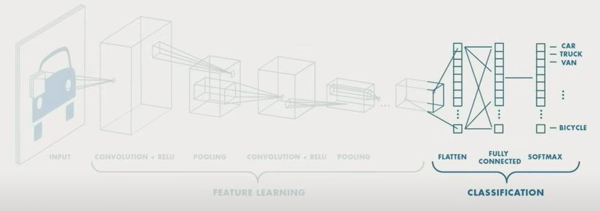

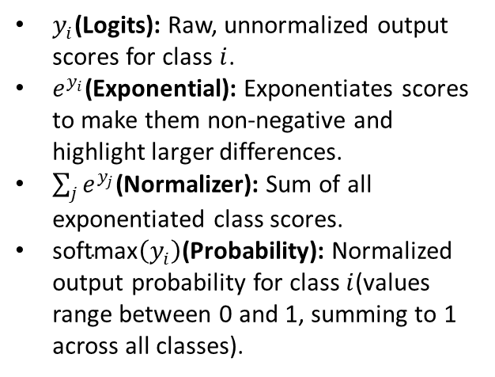
4. CNN for Classification: Class Probabilities
CONV and POOL layers output high-level features of input
Fully connected layer uses these features for classifying input image
Express output as probability of image belonging to a particular class
$y_{i}$(Logits): Raw, unnormalized output scores for class $i$.
$e^{y_{i}}$(Exponential): Exponentiates scores to make them non-negative and highlight larger differences.
$\sum_{j}{e^{y_{j}}}$(Normalizer): Sum of all exponentiated class scores.
$\text{softmax}\left(y_{i}\right)$(Probability): Normalized output probability for class $i$(values range between 0 and 1, summing to 1 across all classes).
Softmax: converts raw, unnormalized prediction scores (logits) into a valid probability distribution to enable final multi-class classification decisions.
30

Slide 31
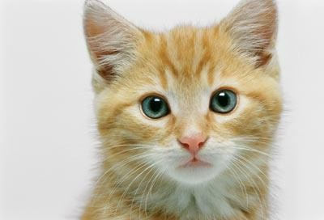

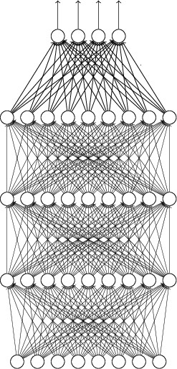




The whole CNN
Input
cat dog ……
Output
Convolution
Max Pooling
Can repeat many times
Fully Connected
Feedforward network
Convolution
Max Pooling
Flattened
31

Slide 32
4. Research Paper: LeNet-5
LeNet demonstrated the effectiveness of convolutional neural networks for visual recognition tasks.
LeCun et al., 1998
LetNet-5-> five trainable layers in the original architecture. C1, P1, C2, P2, C3
32

Slide 33
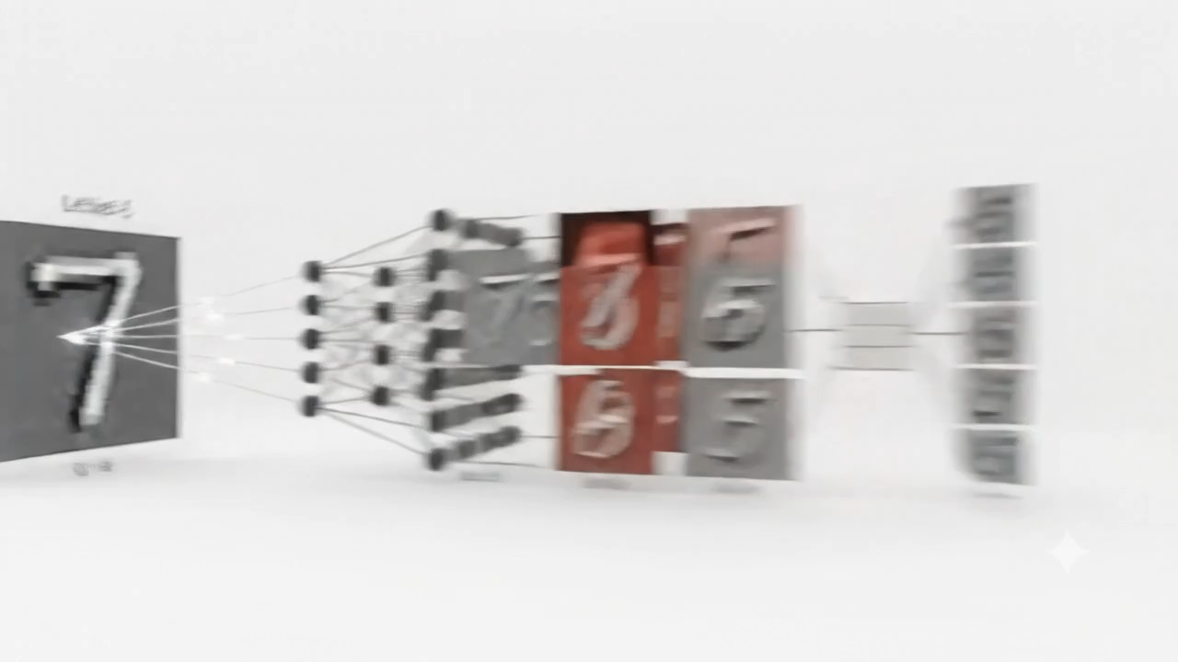
4. LeNet-5 (Example)
LeNet-5 is an early convolutional neural network designed to recognize handwritten digits.
LeNet-5 Architecture Overview
Input Image: Processing a handwritten digit input (7).
Feature Extraction (Convolutions & Subsampling): Alternating convolutional and pooling layers systematically down sample spatial resolution while extracting hierarchical features (edges, curves, loops).
Feature Maps: Intermediate feature maps display active activations responding to distinct patterns of the input digit.
Fully Connected Layers & Classification: Extracted features are flattened and passed through dense layers to output class probabilities for digits 0–9.
33

Slide 34
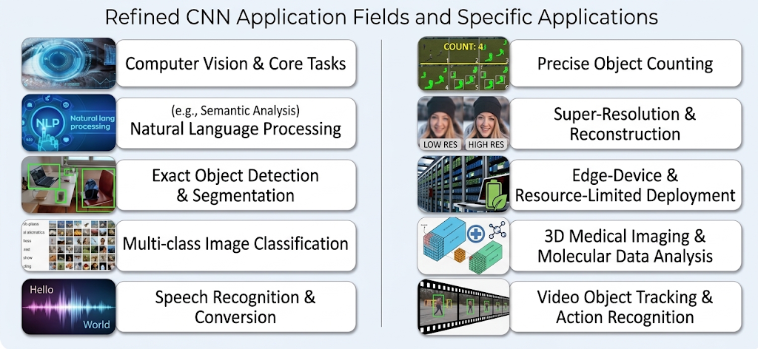
4. (i) Applications of CNNs
CNNs have a wide range of applications, from image and video analysis to medical imaging, speech recognition, and real-world deployment.
34

Slide 35
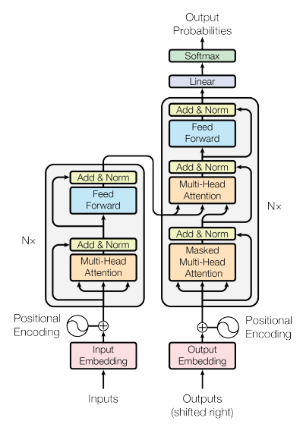
5. Transformer
A Transformer is a deep learning model that helps computers understand and process data.
It uses attention to focus on the most important parts of the input.
It can understand the relationship between different parts of the data.
Transformers are widely used in language, images, and video tasks.
Attention Is All You Need — Vaswani et al., 2017
Main Components
Input Embeddings: Convert words, image patches, or other inputs into numerical vectors.
Positional Encoding: Provides information about the position/order of inputs.
Self-Attention: Learns relationships between different elements.
Feed-Forward Network: Further transforms the learned representations.
Residual Connections (Add) & Layer Normalization: Improve training stability.
Explore Transformer Architecture
Paper link
35

Slide 36
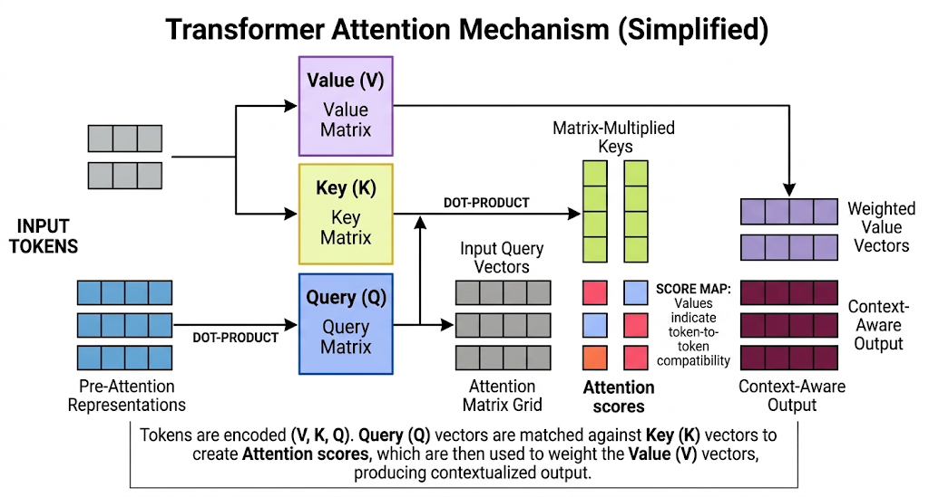
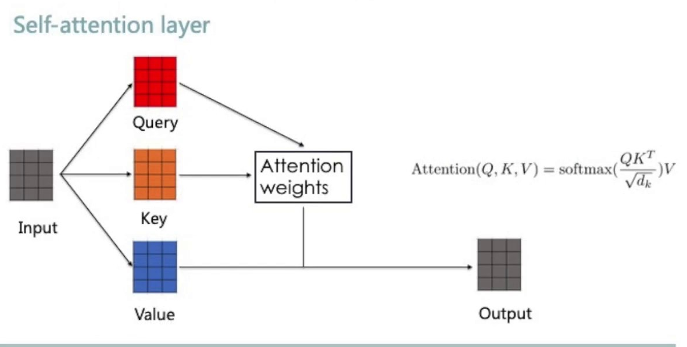
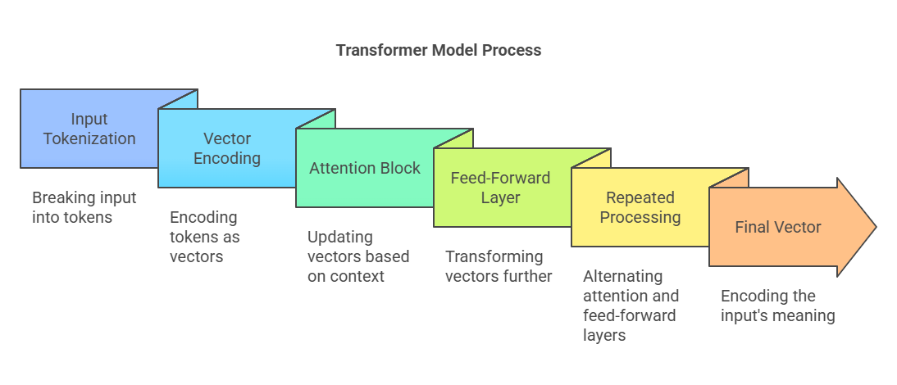
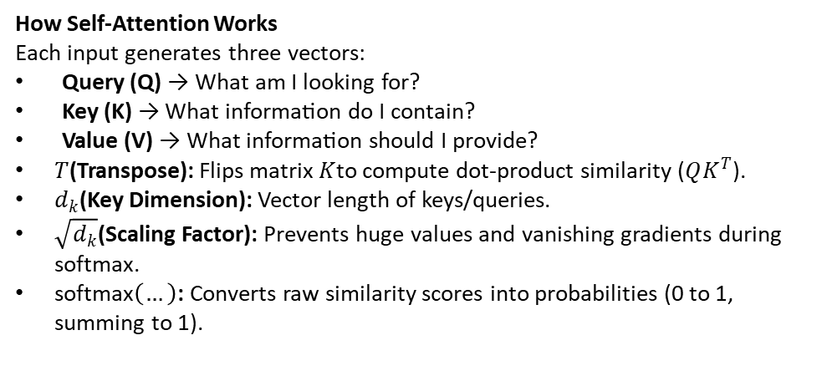
5 (i). Attention Mechanism
Attention allows a model to determine which parts of the input are most important when processing a particular element.
How Self-Attention Works
Each input generates three vectors:
Query (Q) → What am I looking for?
Key (K) → What information do I contain?
Value (V) → What information should I provide?
$T$(Transpose): Flips matrix $K$to compute dot-product similarity ($QK^{T}$).
$d_{k}$(Key Dimension): Vector length of keys/queries.
$\sqrt{d_{k}}$(Scaling Factor): Prevents huge values and vanishing gradients during softmax.
$\text{softmax}\left(…\right)$: Converts raw similarity scores into probabilities (0 to 1, summing to 1).
36

Slide 37
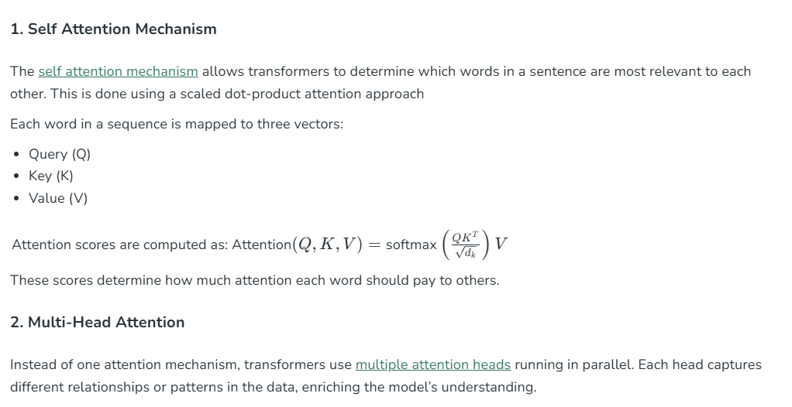
5 (i). Attention Mechanism
37

Slide 38
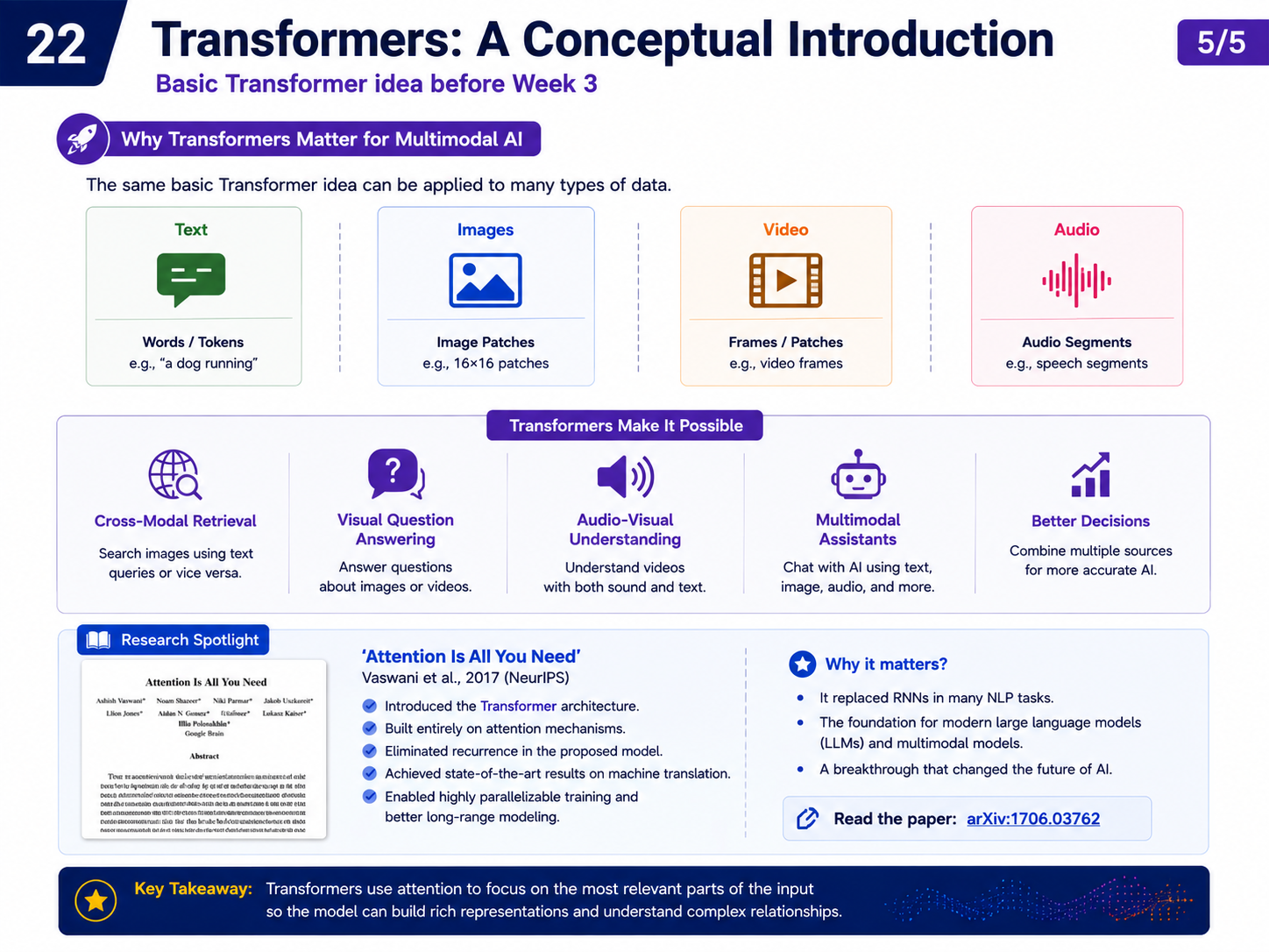
5 (i). Why Transformers Matter for Multimodal AI
1. Cross-Modal Understanding
Learn relationships between different modalities.
Example: connect an image of a dog with the text “A dog playing in the park.”
2. Attention Across Modalities
Attention can connect:
Image regions ↔ Words
Audio ↔ Text
Video frames ↔ Text
3. Unified Representation
Different modalities can be converted into tokens or embeddings.
Transformers process them within a shared representation space.
4. Scalable & Flexible
Can handle large datasets and long sequences.
Can be adapted to many multimodal tasks.
38

Slide 39
6. CNNs vs. Transformers
CNN | Transformer
Uses convolution: applies filters to small, nearby regions of an image. | Uses self-attention: learns relationships between image patches or tokens.
Local patterns: learns edges and textures. Deeper layers capture broader context. | Context: ViT connects distant patches. Swin uses local and shifted windows.
Hierarchical features: combines simple patterns into shapes and object features. | Contextual features: combines information according to relationships between tokens.
Visual tasks: widely used for classification, object detection, and segmentation. | Visual tasks: also supports classification, object detection, and segmentation.
Examples: AlexNet GoogLeNet Inception v1 VGG-16 VGG-19 ResNet-18 / 50 / 101 EfficientNet-B0–B7 | Examples: Transformer Vision Transformer, ViT Swin Transformer Swin-Tiny
39
Notes:
Model
Short description
Original paper
AlexNet (2012)
A deep CNN trained with GPUs for large-scale image classification.
ImageNet Classification with Deep Convolutional Neural Networks
GoogLeNet / Inception v1 (2014)
Combines parallel convolution branches to capture patterns at different scales.
Going Deeper with Convolutions
VGG-16 / VGG-19 (2014)
Builds deep networks by stacking small 3 × 3 convolution filters.
Very Deep Convolutional Networks for Large-Scale Image Recognition
ResNet-18 / 50 / 101 (2015)
Uses residual connections to make deeper networks easier to train.
Deep Residual Learning for Image Recognition
EfficientNet-B0–B7 (2019)
Balances network depth, width and input resolution through compound scaling.
EfficientNet: Rethinking Model Scaling for Convolutional Neural Networks
Vision Transformer (ViT) (2020)
Applies a Transformer to a sequence of image patches.
An Image is Worth 16x16 Words: Transformers for Image Recognition at Scale
Swin Transformer (2021)
Uses shifted attention windows to build hierarchical visual features.
Swin Transformer: Hierarchical Vision Transformer using Shifted Windows
Comparison adapted from the user-provided slide. Years indicate first public introduction/preprint, not always conference publication. Inception v1 and VGG: 2014 preprints, 2015 conference papers. ResNet: 2015 preprint, 2016 CVPR paper. ViT: 2020 preprint, 2021 ICLR paper. Links for variants point to the original family paper.
AlexNet (2012): ImageNet Classification with Deep Convolutional Neural Networks. https://papers.nips.cc/paper_files/paper/2012/hash/c399862d3b9d6b76c8436e924a68c45b-Abstract.html
GoogLeNet / Inception v1 (2014): Going Deeper with Convolutions. https://arxiv.org/abs/1409.4842
VGG-16 / VGG-19 (2014): Very Deep Convolutional Networks for Large-Scale Image Recognition. https://arxiv.org/abs/1409.1556
ResNet-18 / 50 / 101 (2015): Deep Residual Learning for Image Recognition. https://arxiv.org/abs/1512.03385
EfficientNet-B0–B7 (2019): EfficientNet: Rethinking Model Scaling for Convolutional Neural Networks. https://proceedings.mlr.press/v97/tan19a.html
Vision Transformer (ViT) (2020): An Image is Worth 16x16 Words: Transformers for Image Recognition at Scale. https://arxiv.org/abs/2010.11929
Swin Transformer (2021): Swin Transformer: Hierarchical Vision Transformer using Shifted Windows. https://arxiv.org/abs/2103.14030

Slide 40
7. From CNNs & Transformers to Multimodal AI
Multimodal AI combines different input types, such as images and text.
Example: answering a question about a picture
IMAGE INPUT
CNN
Picture of a person
riding a bicycle
Extracts visual features:
person and bicycle
MULTIMODAL FUSION
Combines image features
with the question
TEXT INPUT
TRANSFORMER
“What is the
person riding?”
Encodes the question
and its context
“A bicycle.”
Output
The model uses both what it sees and what the question asks.
40

